Slide 1
Halal Products (Rate List)

Slide 2
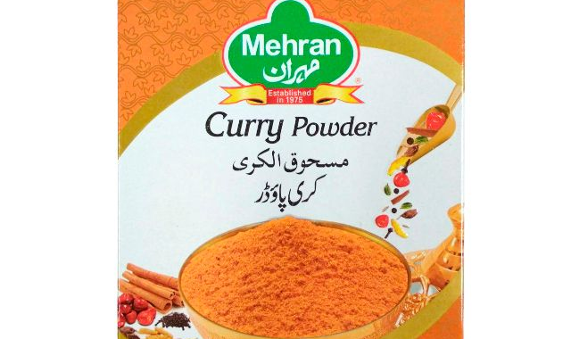
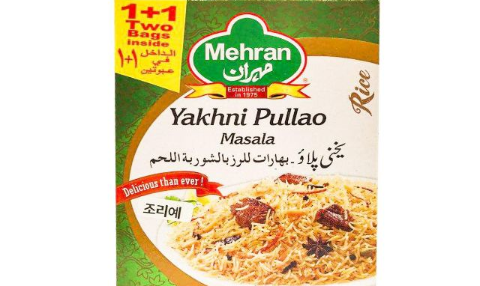

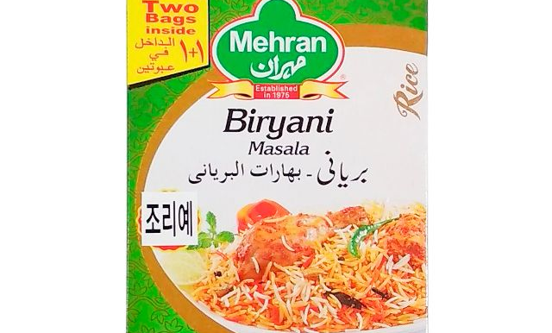
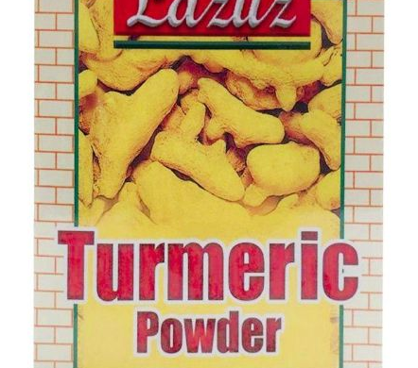
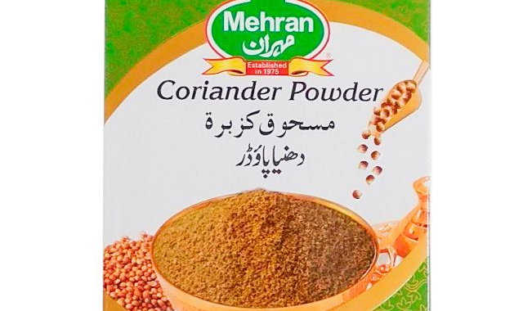
Basic Spices
Curry Powder ₩ 3500
Yakhni Palao ₩ 3000
Cumin Seeds Whole ₩ 4500
Biryani Masala (Mehran) ₩ 3500
coriander Powder ₩ 3500
Turmeric Powder ₩ 3900

Slide 3
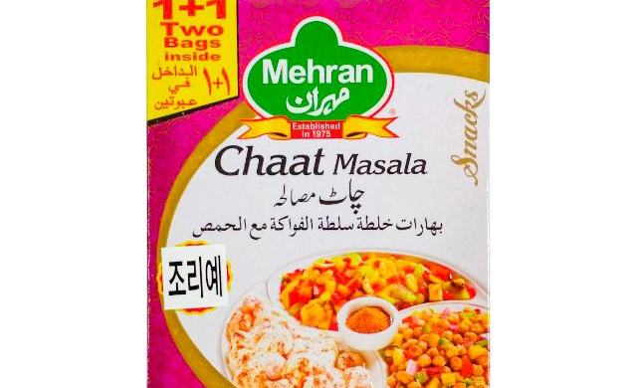
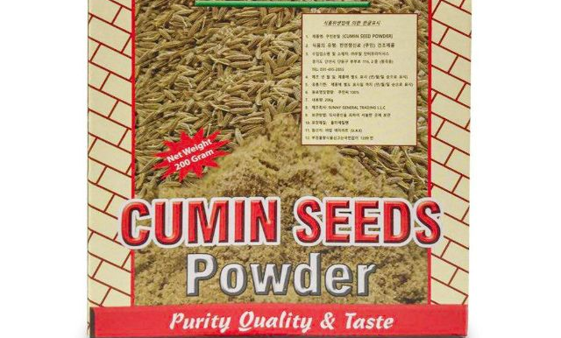
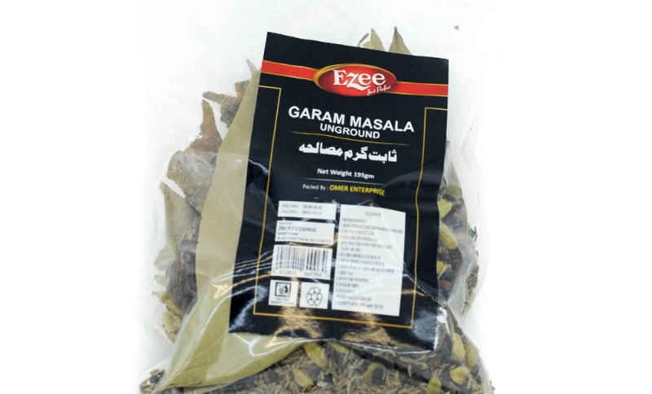
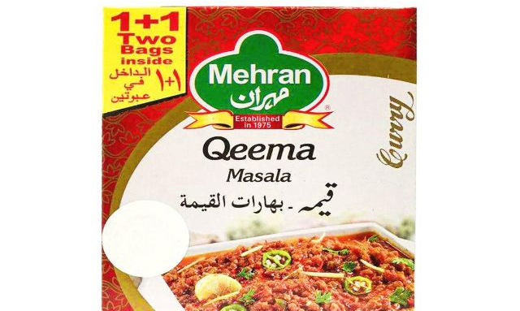
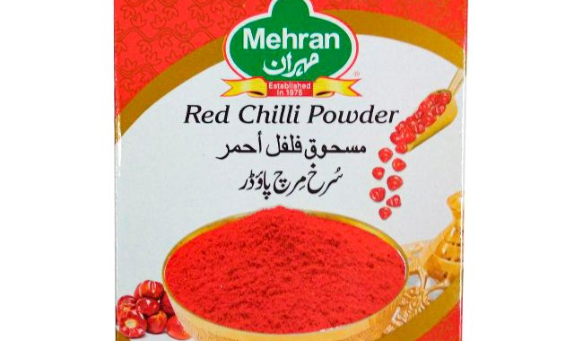
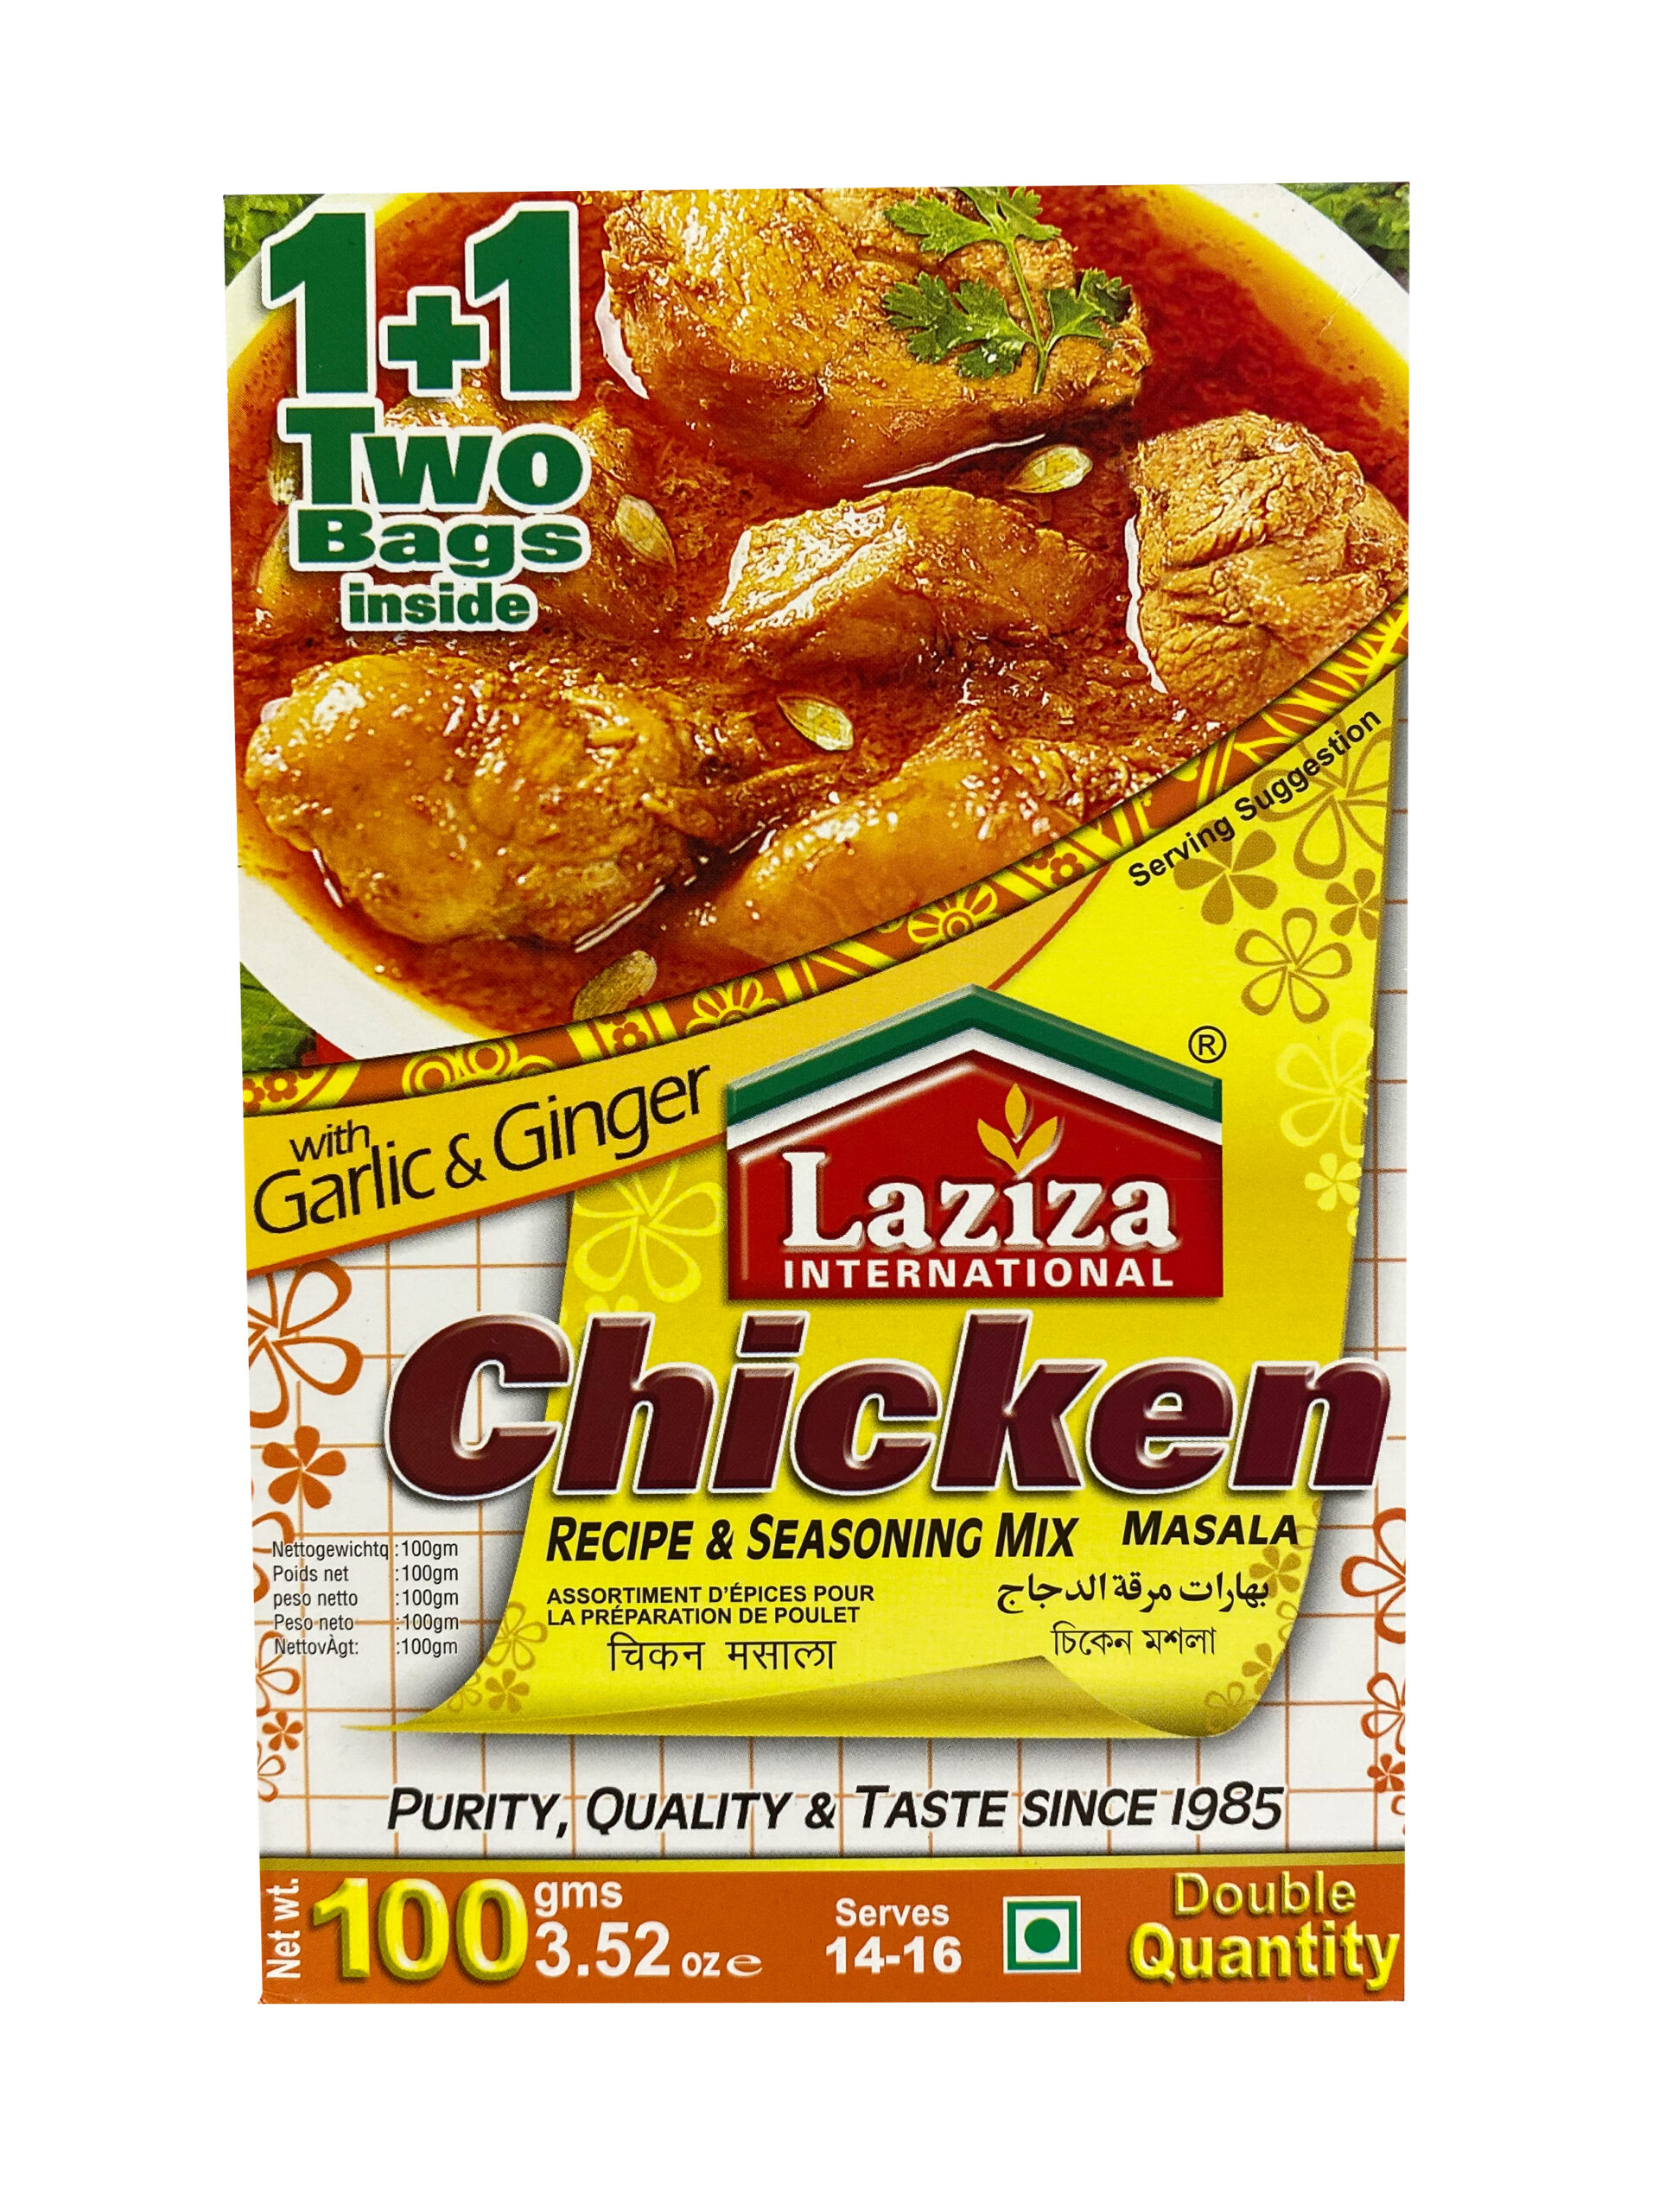
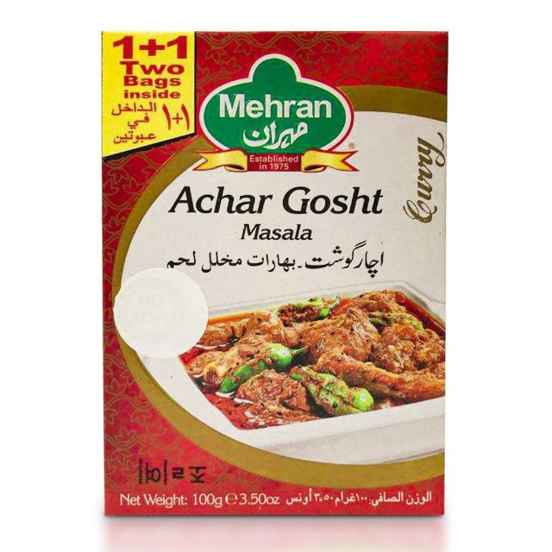
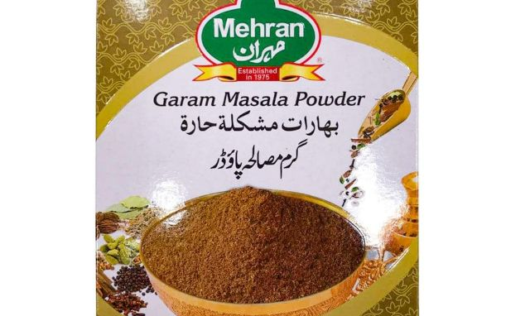
SPICES SECTION (1/2)
Basic Spices
Chaat Masala (Mehran) ₩ 3200
Cumin Seeds Powder (Laziz) ₩ 4000
Garam Masala Whole (EZEE) ₩ 6500
Qeema (Mehran) ₩ 3500
Red Chilli Powder ₩ 5500
Chicken Masala Laziza
3500 Won
Achar Ghost ₩ 3500
Garam Masala Powder ₩ 6500

Slide 4
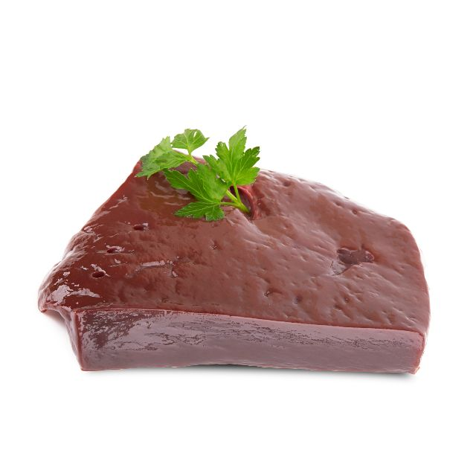
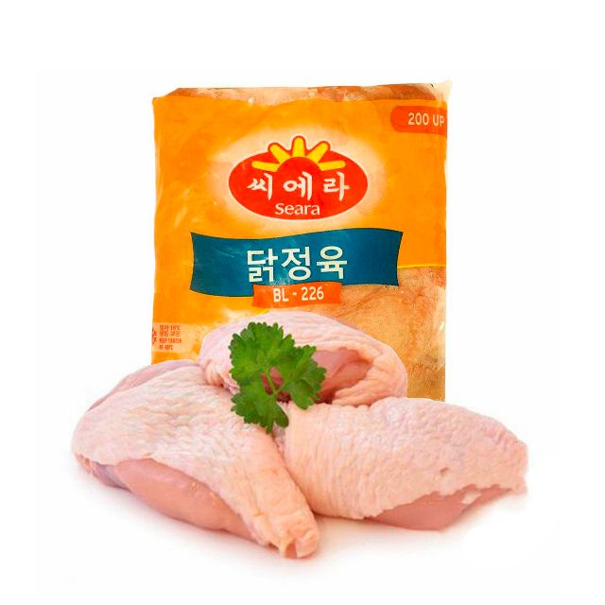
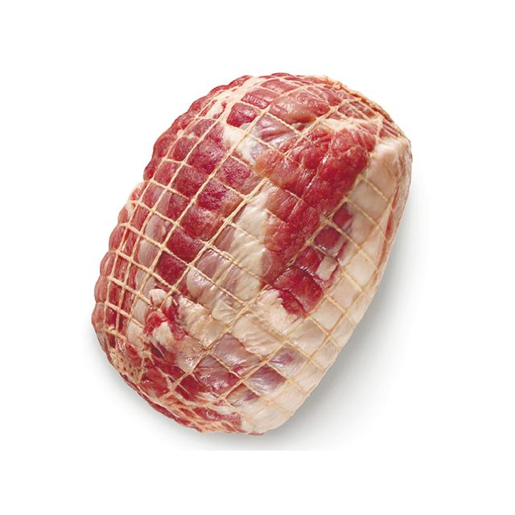
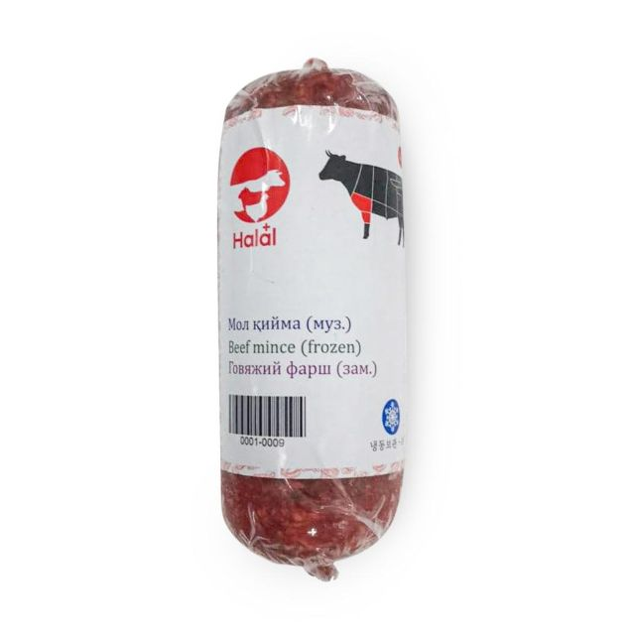
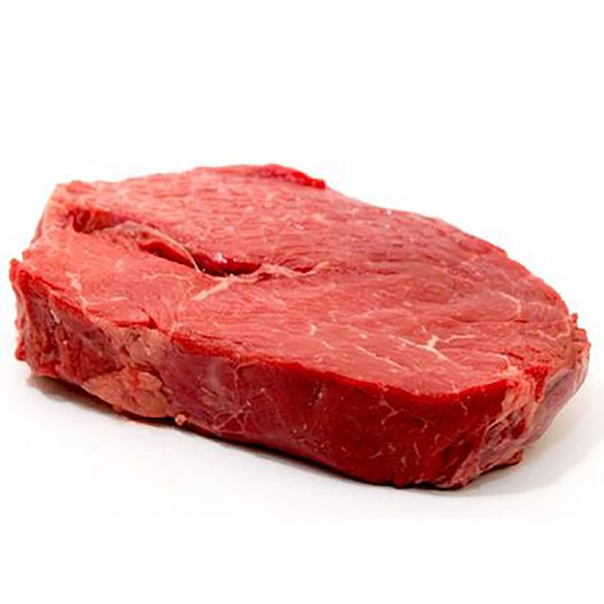
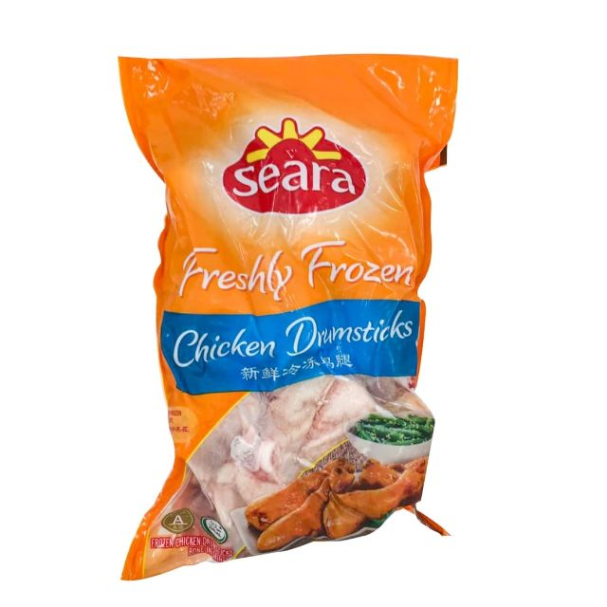

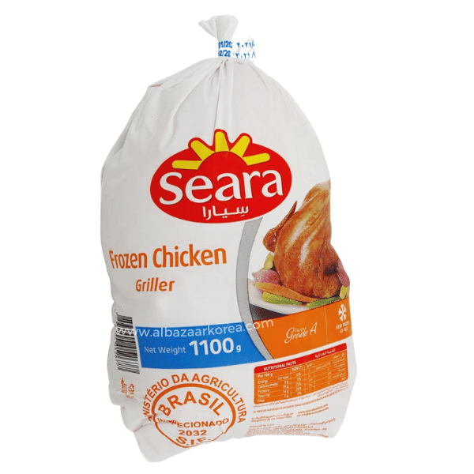
MEAT & CHICKEN
Meat Products
LAMB-Boneless (₩ 149/10 grams) ₩ 15,900/kg
BEEF-Liver (kaleji) (700 grams)
₩ 4900
CHICKEN-(Leg Boneless)-(2kg) ₩ 10000
BEEF-Boneless (₩139/10 grams) ₩ 13,900/kg
BEEF-Qeema (800 grams) ₩ 10500
CHICKEN-(Breast Boneless) (2kg) ₩ 10000
CHICKEN-(Whole) (1100 g) 5400 ₩
CHICKEN-(Drumsticks) - 2kg ₩ 9900

Slide 5
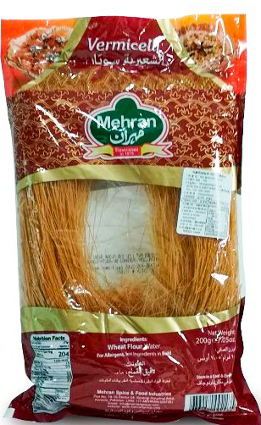
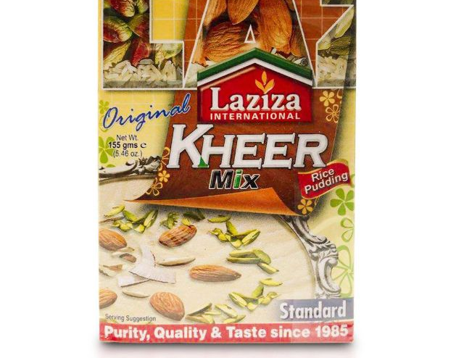
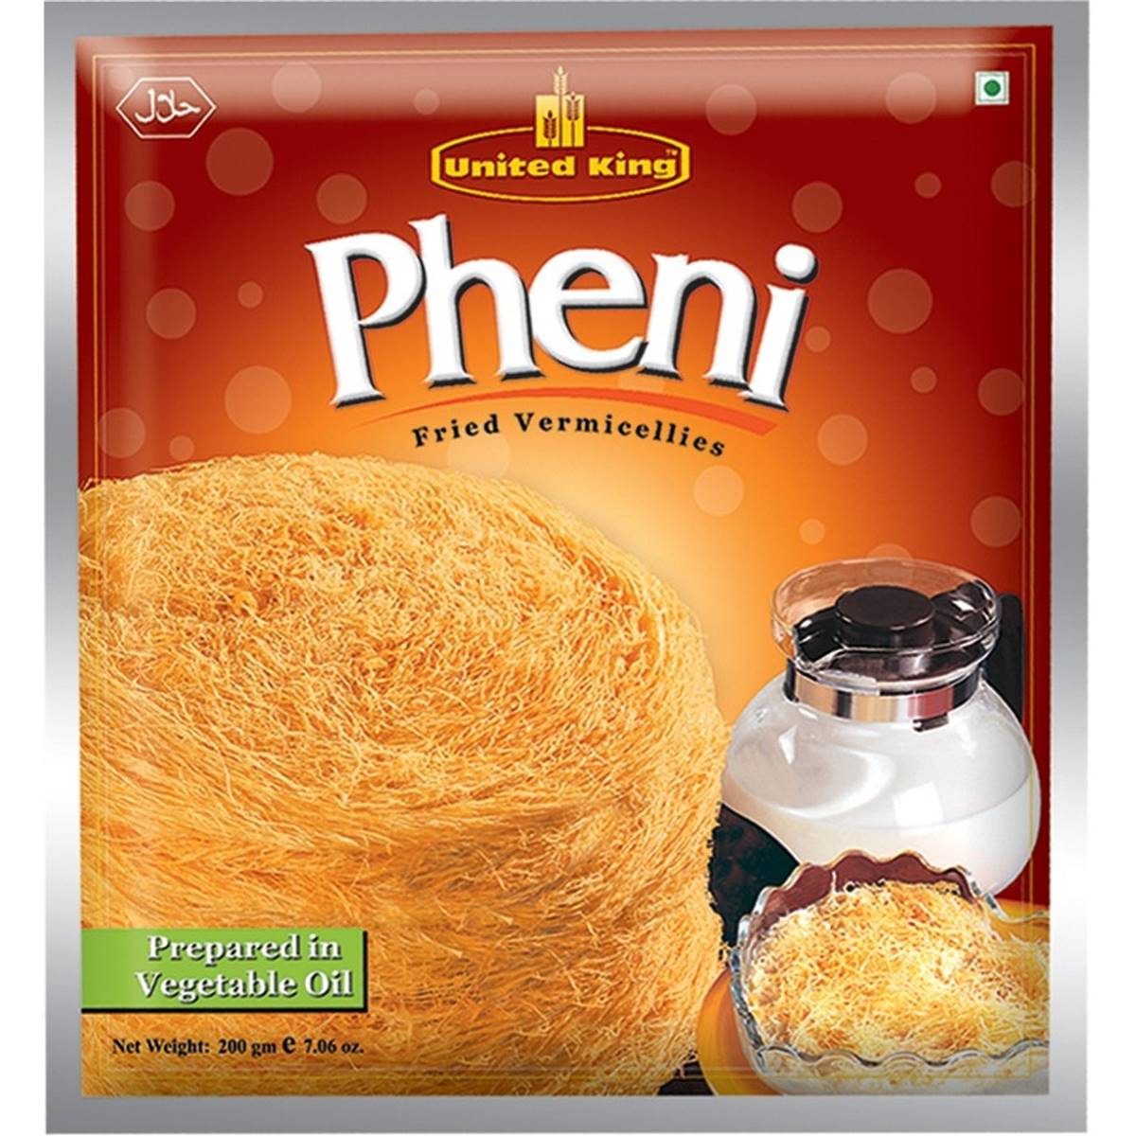
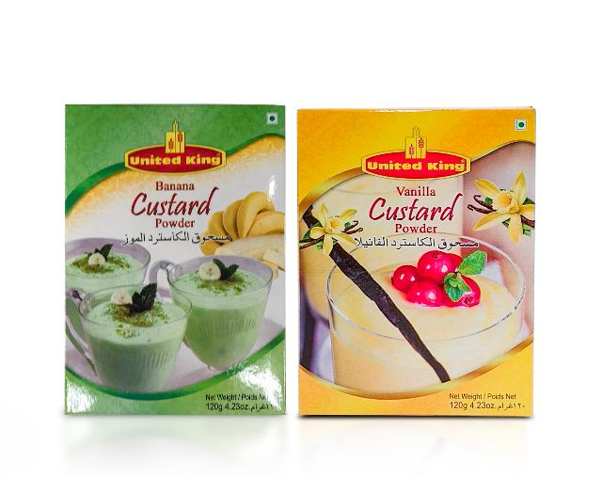
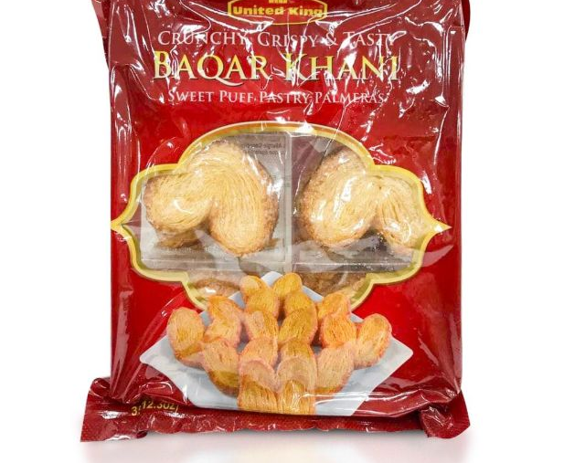
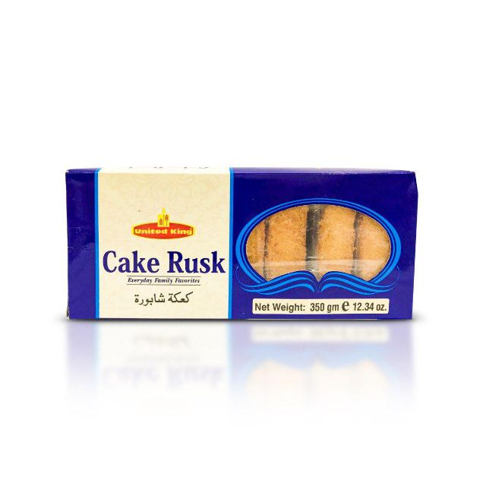
Sweets & Snacks
Vermicillies (Mehran) ₩ 1500
KHEER MIX (Laziza) ₩ 4000
PHENI--- ₩ 3500
CUSTARD POWDER VANILLA & Banan ₩ 2500
BAQAR KHANI
₩ 3200
CAKE RUSK --- ₩ 3900

Slide 6
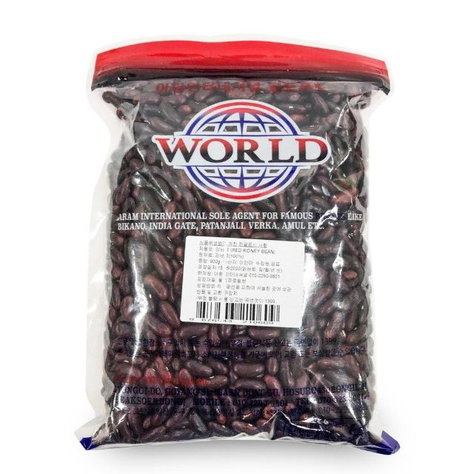
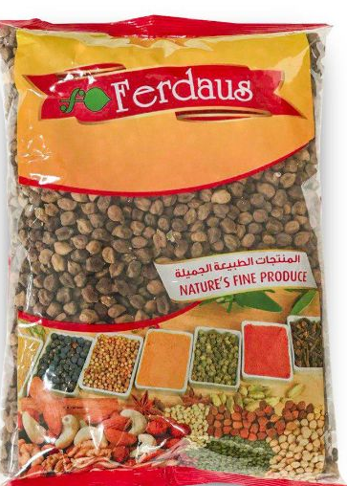
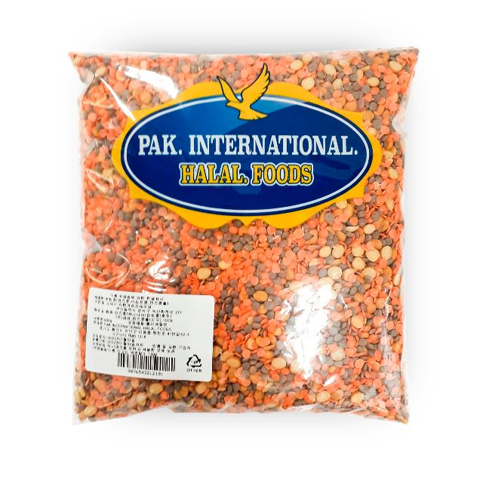
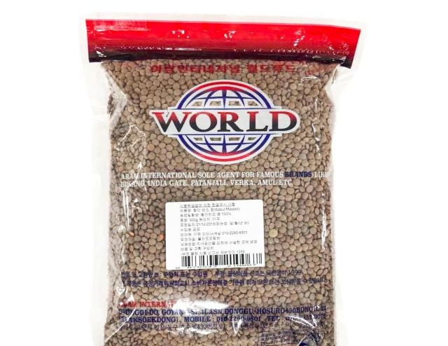
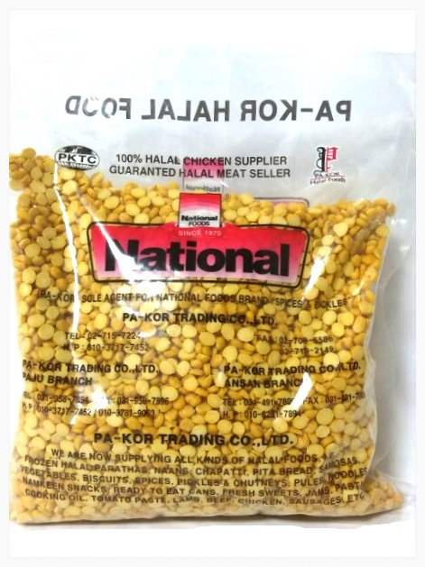
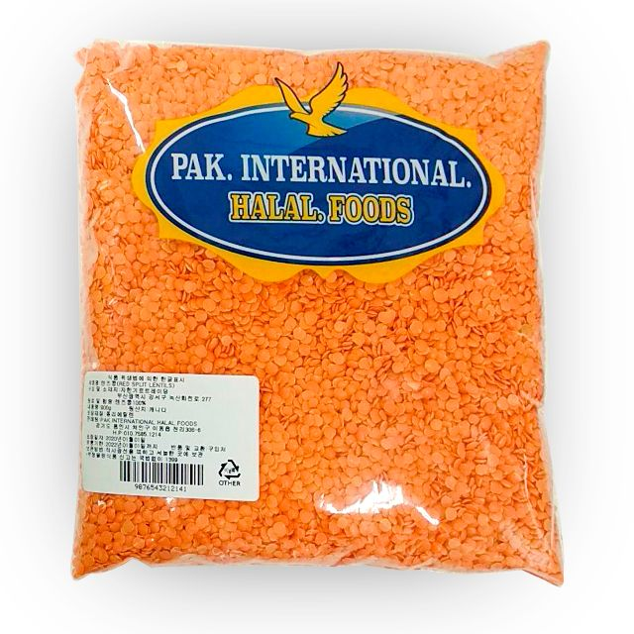
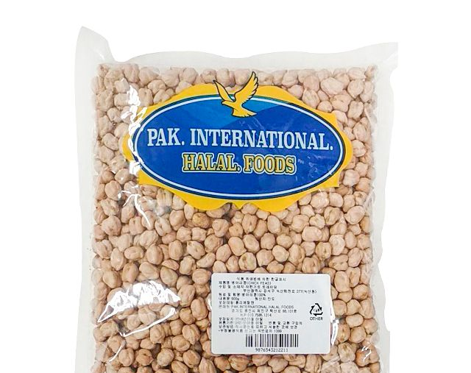
Daal Channa ₩ 3200
Lentils & Grains
RED BEANS (LOBIA)
₩ 3500
Black Channa
₩ 3200
Mix Masoor
₩ 3000
Whole Masoor
₩ 3500
Simple Masoor
₩ 4900
White Channa
₩ 4000

Slide 7
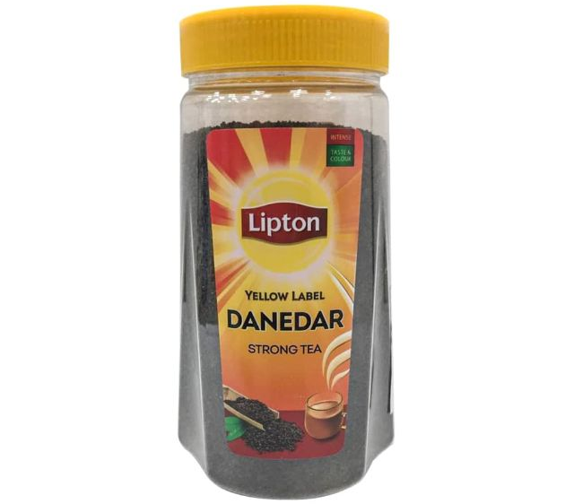
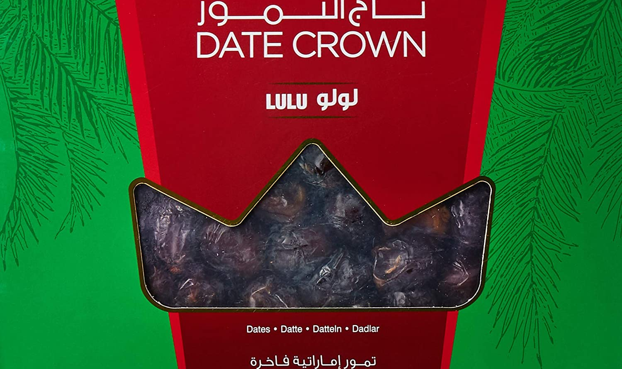
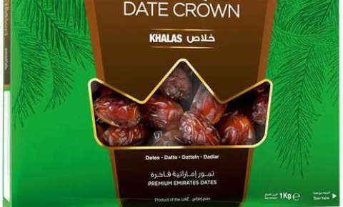
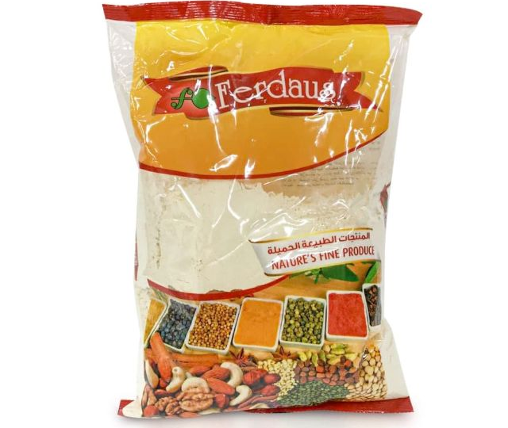
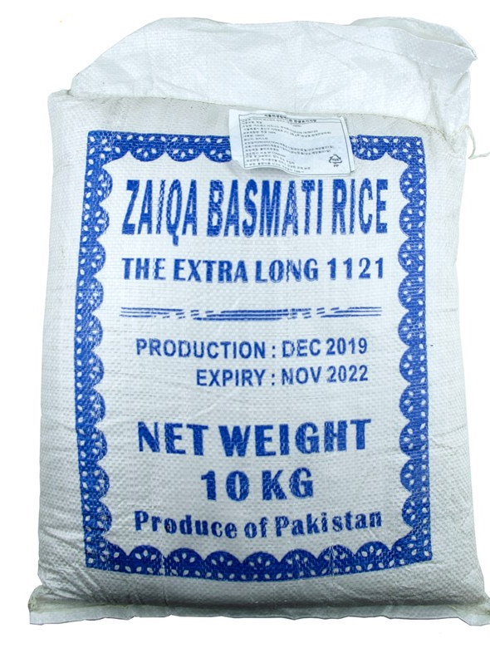
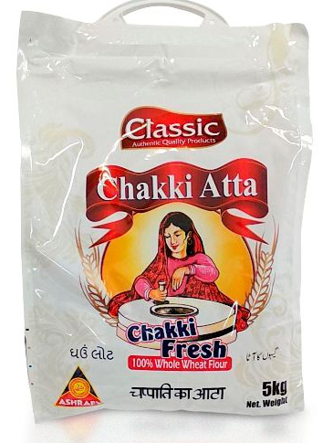
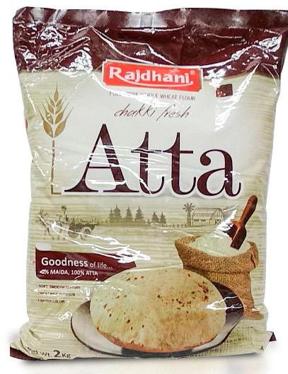
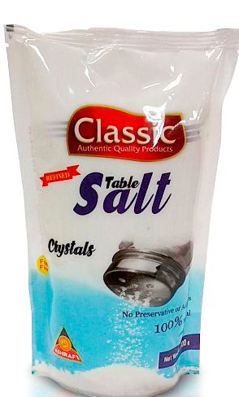
BASIC FOOD
Flour , Rice , Black Tea and Dates
TEA - LIPTON
₩ 8500
BESAN-(Ferdaus) ₩ 4000
DATES-(DHALAS)
₩ 5500
DATES-(LULU)
₩ 6500
Classic Table Salt
₩ 1700
ATTA - Classic
₩ 7500
ATTA - RAJDHANI
₩ 7500
Basmati Rice 1 Kg
5,500

Slide 8
We are serving these Halal Products to help Muslim community of JNU, this service has no business perspective. Little profit obtained from sales is used for the Monthly rent of Masjid. Thanks !!

